Slide 1
OIL PRICE PREDICTION
Crude oil is a significant energy source in the world. The changes in crude oil prices have an important impact on the economic activities of countries all over the world. There were some investigations focused on applying machine learning and deep learning to predict the prices of crude oil.

Slide 2
NAMES:
DHANANJAY KINGRE
SAMIKSHA PATRE
SHUBHAM WAGH
MANNE BHASKAR

Slide 3
AGENDA
EDA
FEATURE ENGINEERING
VECTORIZATION
MODEL BUILDING
DEPLOYMENT

Slide 4
EXPLOTARY DATA ANALYSIS
EDA is applied to investigate the data and summarize the key insights. It will give you the basic understanding of your data, it's distribution, null values and much more. You can either explore data using graphs or through some python functions.
STEP 1: Importing all the required libraries.
STEP 2: Read the csv file of Dataset.
STEP 3: Get all the summary of the Dataset list of all columns with their datatype, also list of non-null values.
STEP 4: Dropping the unnecessary columns from the dataset.
STEP 5 : List of columns and check the Dimensions.
5751 rows and 3 columns

Slide 5
STEP 6: isnull().sum() It is used to detect missing values Dataframe .isnull is an alias for DataFrame, Return a Boolean same sized object indicating if the values are NA. NA values such as none or numpy.Nan, get mapped to true values.
But we found that there are no NULL values found in the dataset.
Handling missing values:

Slide 6
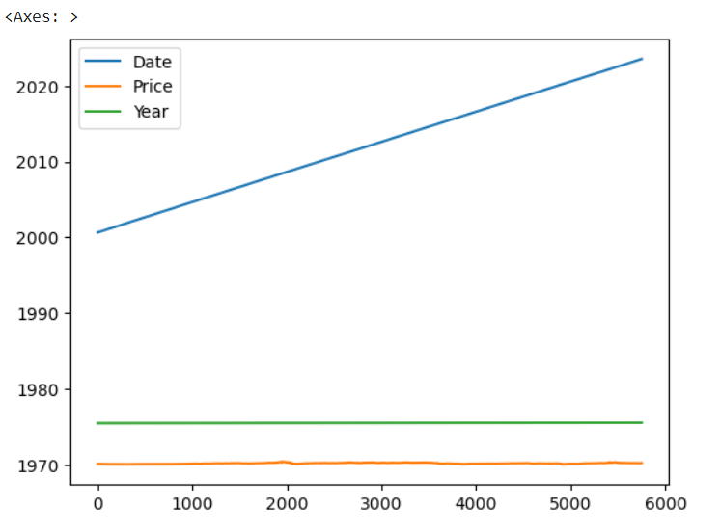
DATA VISUALIZATION
Line Plot: Connects a series of data points using a line. This chart type presents sequential values to help you identify trends. Most of the time, the x-axis represents a sequential progression of values.

Slide 7
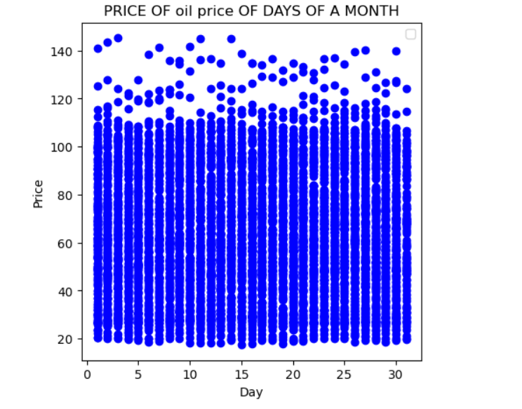
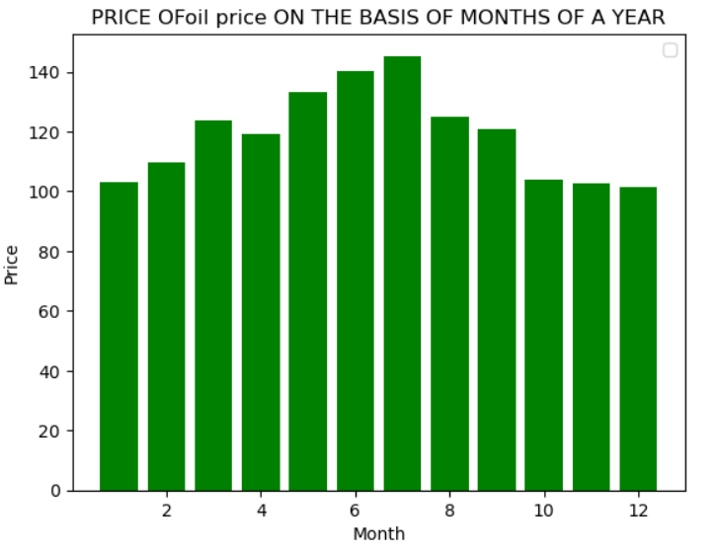
Price of oil

Slide 8
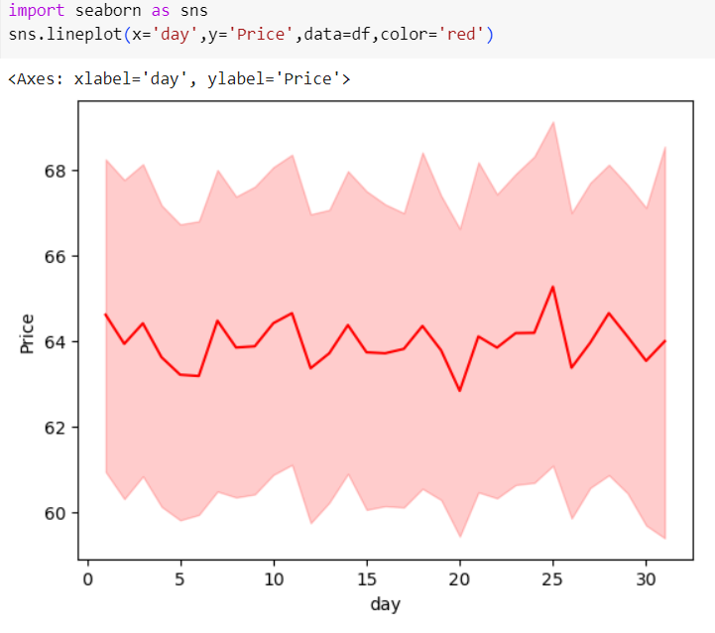
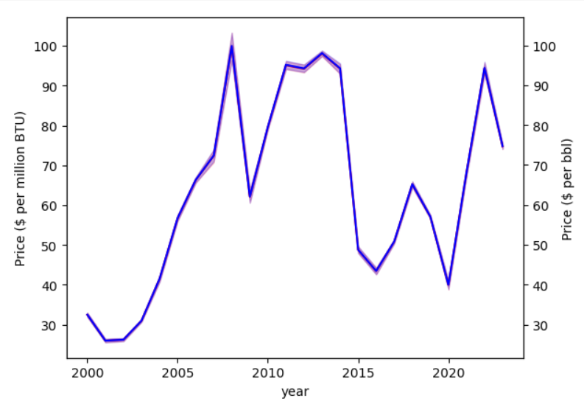
Line plot

Slide 9
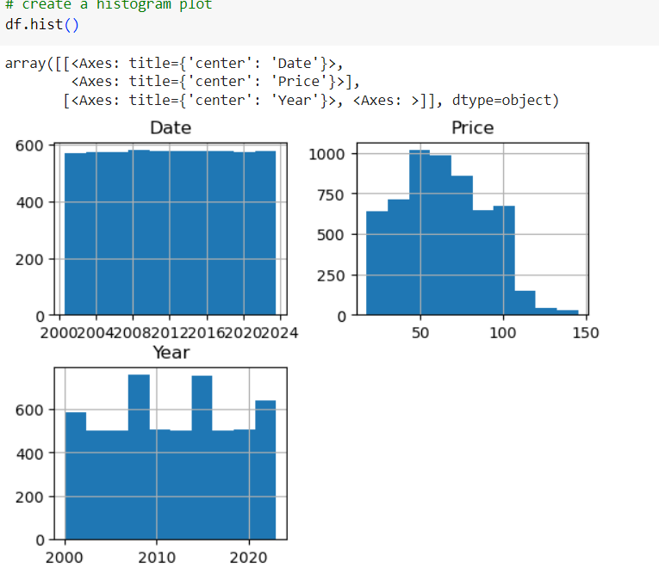
Histogram
is a graph that shows the frequency of numerical data using rectangles. The height of a rectangle represents the distribution frequency of a variable.

Slide 10
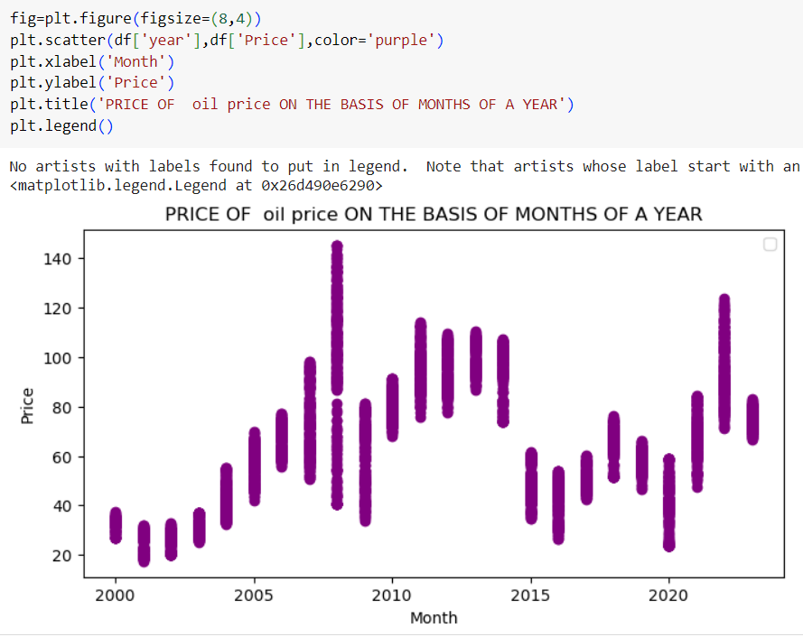

Slide 11
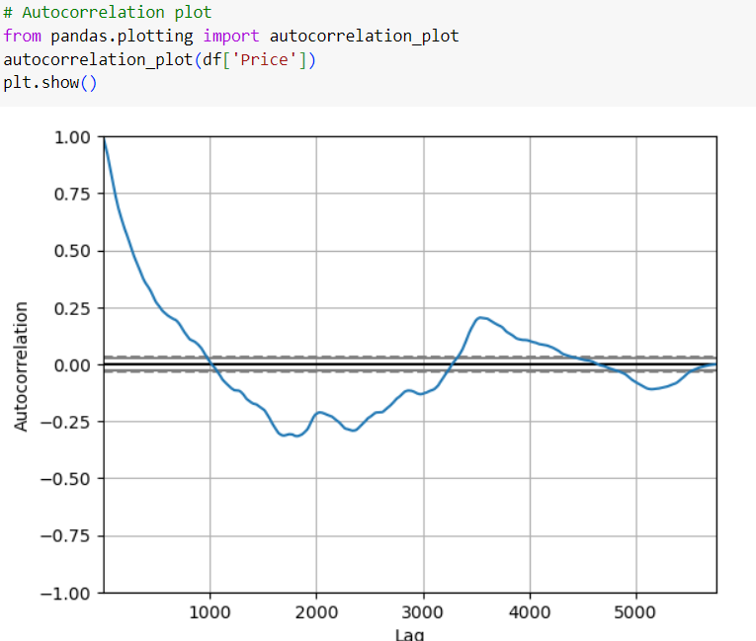
Autocorrelation plot Are a commonly-used tool for checking randomness in a data set.

Slide 12
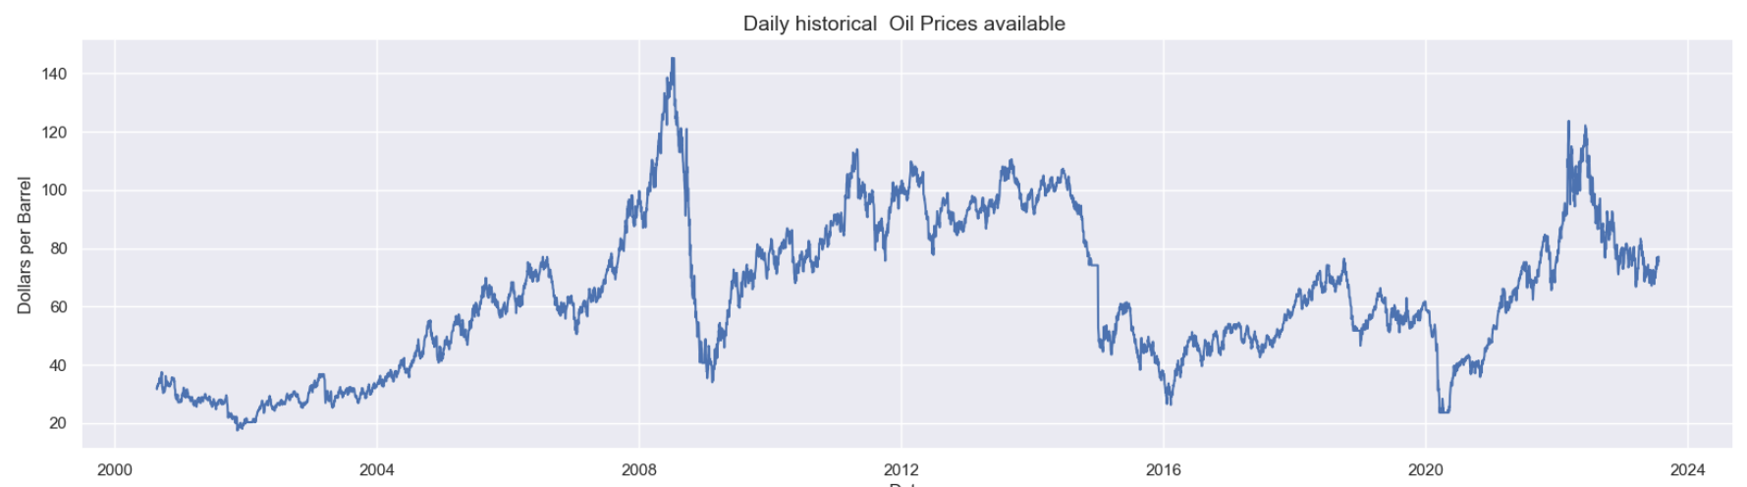
Daily Availability

Slide 13
Data partition
Now, Split the dataset into X(independent variable) and Y(dependent variable)
Split data into train and test
x_train.shape (4600, 3)
y_train.shape(4600, 1)

Slide 14
Model building
Decision tree regression
A decision tree is a non-parametric supervised learning algorithm, which is utilized for both classification and regression tasks. It has a hierarchical, tree structure, which consists of a root node, branches, internal nodes and leaf nodes.
Accuracy Score: 0.99

Slide 15
Bagging regressor
Training Error: 0.96
Test Error: 10.857
Bagging - Difference of Train and Test: 0.9
Accuracy score : 0.96

Slide 16
Random Forest
Random Forest is a popular machine learning algorithm that belongs to the supervised learning technique. It can be used for both Classification and Regression problems in ML. It is based on the concept of ensemble learning, which is a process of combining multiple classifiers to solve a complex problem and to improve the performance of the model.
Accuracy score: 0.91

Slide 17
Logistic Regression
This type of statistical model (also known as logit model) is often used for classification and predictive analytics. Logistic regression estimates the probability of an event occurring, such as voted or didn't vote, based on a given dataset of independent variables.
Step 1: Importing the necessary libraries from scikit learn.
Accuracy score: 0.096

Slide 18
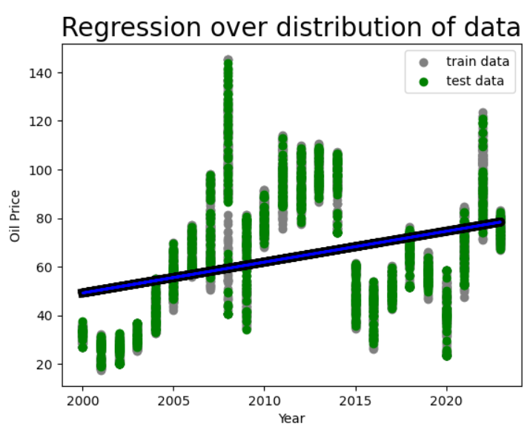

Slide 19
DEPLOYMENT
Since the accuracy is best in Random Forest,
We got the conclusion that Random Forest is the best suitable model for Deployment of the Oil Price Prediction.
Select the date accordingly and the Price of Oil will be Predicted.

Slide 20
